Slide 1
Anonymous Landing page top navigation
I am here to:
Employee Login
Broker Login
Employer Login
Cobra Resourses
What Is Cobra
Online Chat

Slide 2
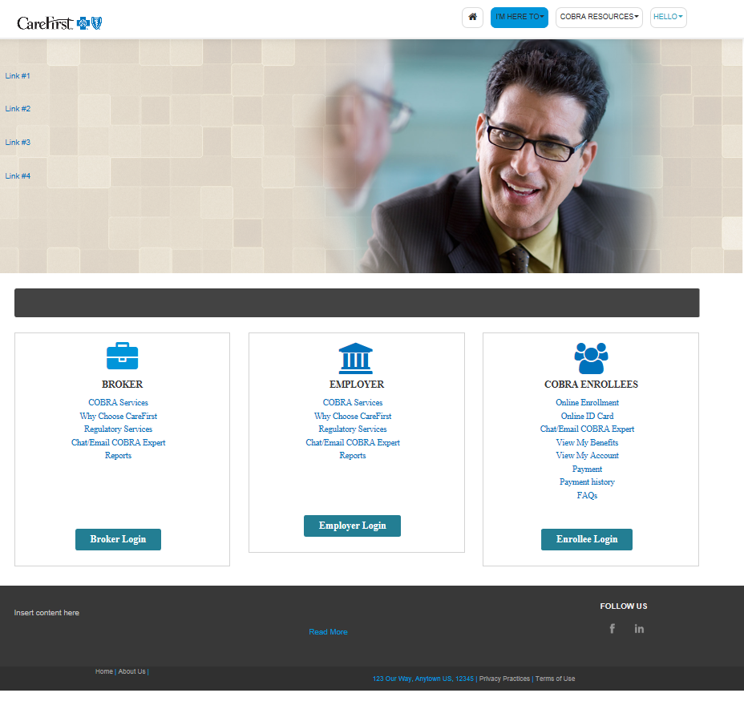
Anonymous Landing page top Panel
Sliding panel
Link 1 = What is COBRA
Link 2 = Cobra FAQ’S
Link 3 = Chat

Slide 3
Anonymous Landing page Bottom Panel
Insert temp disclaimer below
CareFirst Administrators is an independent licensee of the Blue Cross and Blue Shield Association, serving the businesses of Maryland, portions of Northern Virginia, and the District of Columbia. ® Registered trademark of the Blue Cross and Blue Shield Association. ®' Registered trademark of CareFirst of Maryland, Inc.

